Slide 1

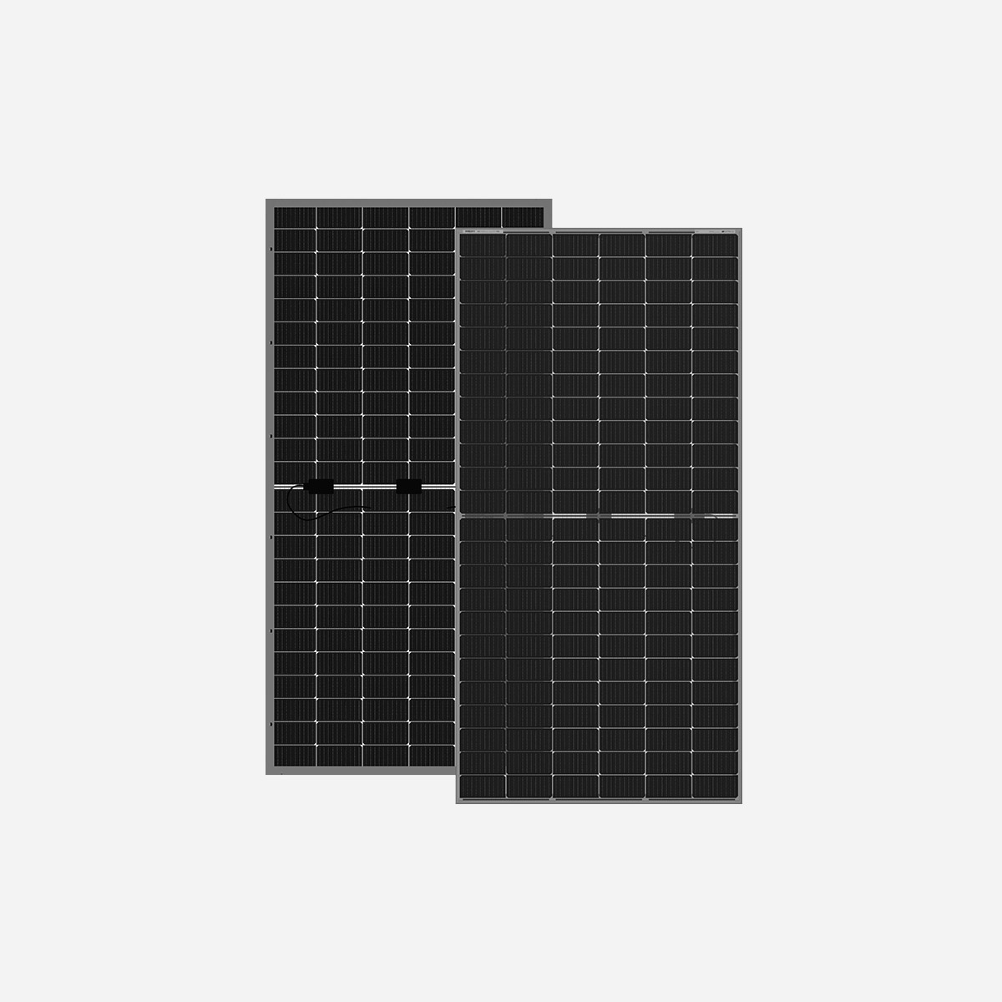









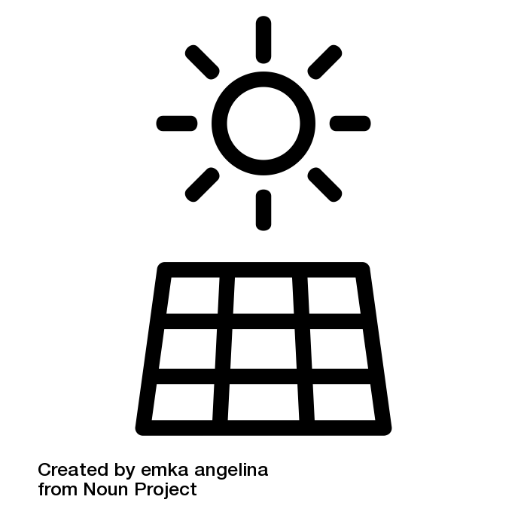

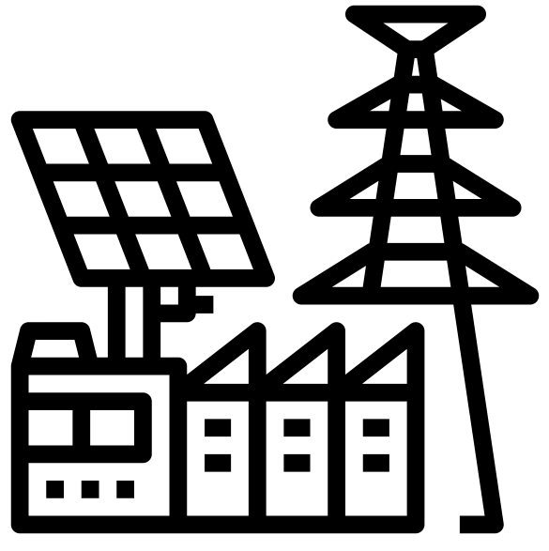








ABS-144GGB-M10
585W – 605W
Topcon Half Cut PV Module
Glass/Glass-Black Frame
605W
MAXIMUM POWER OUTPUT
+10W
OUTPUT POSITIVE TOLERANCE
Guaranteed 0~+10W positive tolerance ensures power output reliability.
23.4%
MAXIMUM EFFICIENCY
KEY FEATURES
LINEAR PERFORMANCE WARRANTY
LOW SYSTEM COST
Higher yield per surface area, lower BOS costs, higher power classes, and an efficiency rate of up to 23.42%.
100%
99%
95%
^{A}DDED VALUE FROM WARRANTY
Guaranteed Power Performance
87.40%
EXTREME WEATHER RATING
High-tech aluminum alloy frame, certified for high snow (5400 Pa) and wind loads (2400 Pa).
90%
85%
80%
1
5
10
15
20
25
30
ADVANCED MODULE TECHNOLOGY
Highest reliability & enhanced crack tolerance MBB module
Product warranty
30
Years
years
30-year Warranty for Extra Linear Power Output
ALL-WEATHER TECHNOLOGY Optimal
Yields, whatever the weather, with low-light and temperature behaviour.
Product warranty
12
Years
12-year Warranty for Materials and Processing (1st year ≤ 1.0%, 2nd~30th years ≤ 0.40% / year)
BETTER TEMPERTURE COEFFICIENT
Lower temperature coefficient (Pmax):
-0.30%/°C, increases energy yield in hot climate
THE IDEAL SOLUTION FOR
PID
ENDURING HIGH PERFORMANCE
Anti LID and Anti PID Technology. Under long-term production safety conditions, the limited power degradation caused by the PID effect is guaranteed.
Residential
Commercial
Off-Grid
Utility
COMPREHENSIVE CERTIFICATES
ADVANTAGES
IEC 61215 | IEC 61730 | IEC 61701 | IEC 62716
MADE IN UAE
Premium products are 100% made in the Emirates.
A RELIABLE INVESTMENT
Products up to 725Wp, 30 years of performance warranty.
ENCOURAGING INNOVATION
Innovative, prestigious, European production technology
UL 61730 | CEC | ISO 9001 | ISO 14001| ISO 45001
Address: Abundance Solar Panels Industries – LLC Plot No 7-8, KHIA5KEZAD, Abu Dhabi, UAE

Slide 2
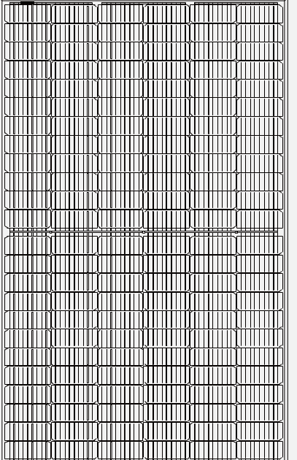

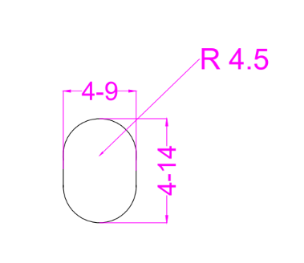

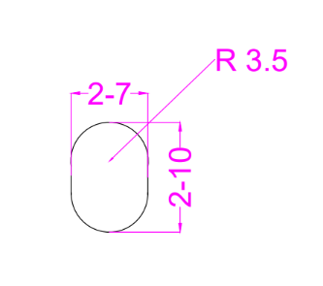
ABS-144GGB-M10-585-605W
ENGINEERING DRAWINGS & TECHNICAL PARAMETERS
ELECTRICAL CHARACTERISTICS (STC/NOCT)
Models | Maximum Rating Power (Pmax) (W) |  | Open Circuit Voltage (Voc) (V) |  | Maximum Power Voltage (Vmp) (V) |  | Short Circuit Current (Isc) (A) |  | Maximum Power Current (Imp) (A) |  | Module Eﬃciency (EFF)(%)
 | STC | NOCT | STC | NOCT | STC | NOCT | STC | NOCT | STC | NOCT
ABS-144GGB-M10-585 | 585 | 437.3 | 51.62 | 48.53 | 44.50 | 41.52 | 14.04 | 11.33 | 13.22 | 10.59 | 22.65%
ABS-144GGB-M10-590 | 590 | 441.0 | 51.73 | 48.64 | 44.60 | 41.61 | 14.08 | 11.36 | 13.29 | 10.64 | 22.84%
ABS-144GGB-M10-595 | 595 | 444.8 | 51.87 | 48.77 | 44.70 | 41.71 | 14.11 | 11.39 | 13.37 | 10.71 | 23.03%
ABS-144GGB-M10-600 | 600 | 448.5 | 51.97 | 48.86 | 44.80 | 41.80 | 14.13 | 11.40 | 13.45 | 10.77 | 23.23%
ABS-144GGB-M10-605 | 605 | 452.2 | 52.11 | 48.99 | 44.92 | 41.91 | 14.14 | 11.41 | 13.52 | 10.83 | 23.42%
*Standard Test Condition (STC): Cell Temperature 25 °C, Irradiance 1000 W/m², AM 1.5, Nominal module operating temperature (NMOT): Air mass AM 1.5, Irradiance 800W/m², temperature 20°C, windspeed 1 m/s. Reduction in eﬃciency from 1000W/m² to 200W/m² at 25°C: 3.5 ± 2%. *Values without tolerance are typical numbers. Measurement tolerance: ± 3%
BI-FACIAL OUTPUT-BACKSIDE POWER GAIN
Models |  | ABS-144GGB-M10-585 | ABS-144GGB-M10-590 | ABS-144GGB-M10-595 | ABS-144GGB-M10-600 | ABS-144GGB-M10-605
10% | Power | 644 | 649 | 655 | 660 | 666
 | Eff | 24.91% | 25.12% | 25.34% | 25.55% | 25.76%
15% | Power | 673 | 679 | 684 | 690 | 696
 | Eff | 26.04% | 26.27% | 26.49% | 26.71% | 26.93%
20% | Power | 702 | 708 | 714 | 720 | 726
 | Eff | 27.18% | 27.41% | 27.64% | 27.87% | 28.10%
25% | Power | 731 | 738 | 744 | 750 | 756
 | Eff | 28.31% | 28.55% | 28.79% | 29.03% | 29.28%
Solar Cell | Topcon 182.2 x 91.88 mm M10 ,16BB
No.of cells | 144 (6×24)
Dimensions | 2278 mm x 1134 mm x 30 mm ( 89.69” x 44.65“ x 1.18” inch)
Weight | 32 kg / 70.54 lbs.(±3%)
Front Glass | 2.0 mm, High Transmission, Low Iron, Tempered ARC Glass
Cell Encapsulation | EPE(Expanded polyethylene) & EVA (Ethylene-Vinyl-Acetate)
Back Glass | 2.0 mm Semi Tempered Glass with Glaze
Frame | Black Anodized Aluminum Alloy Type 6005T6 , Black Color
Junction Box | IP68, 1500VDC, 3 Bypass Diodes
Connectors Type | IP68 MC4 Compatible
Cable | 400mm or 1300 mm, 4mm²
Package Conﬁguration | 36 pcs Per Pallet, 720 pcs per 40’ FT container ( Two pallets=One stack )
CURRENT-VOLTAGE CURVE UNDER DIFFERENT IRRADIANCE

